Slide 1

Movie Recommendation
Data Exploration

Slide 2
Concept

Slide 3
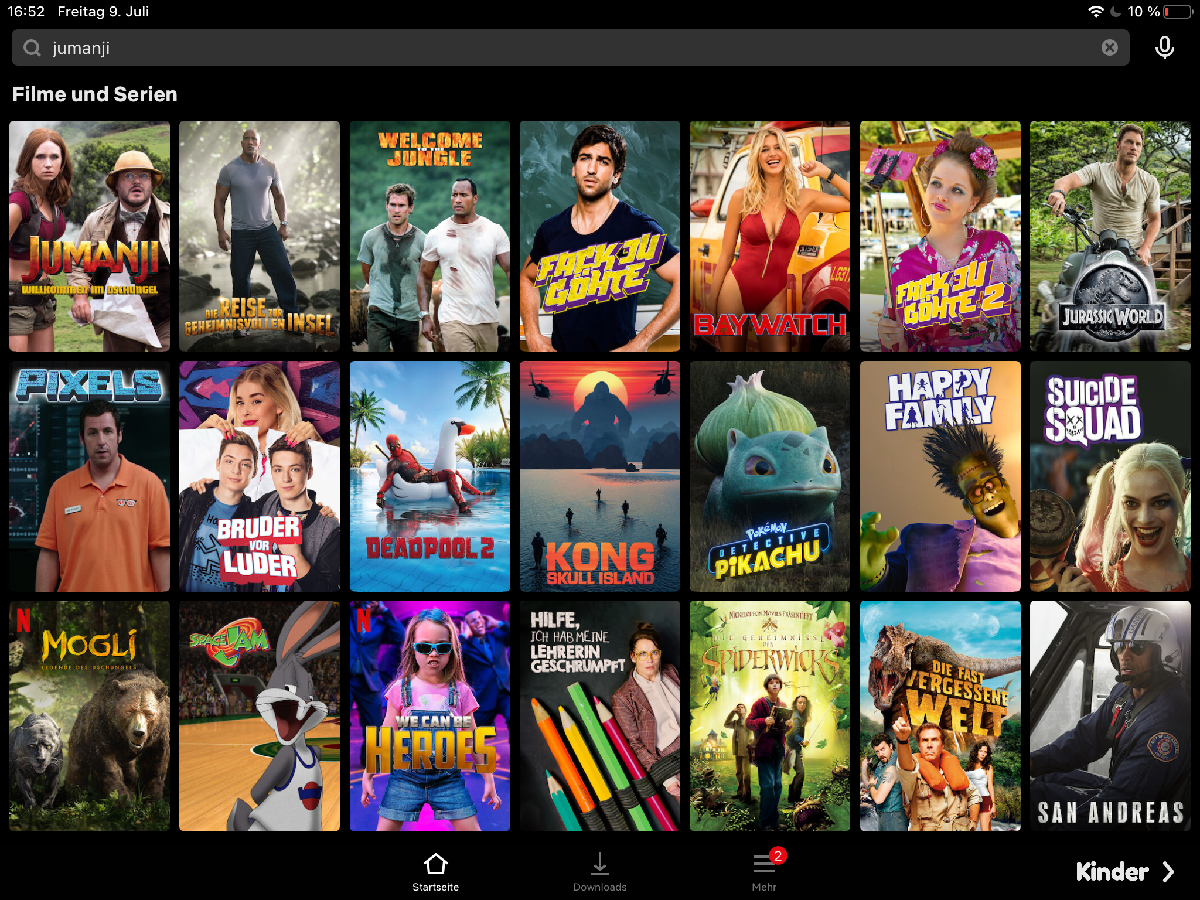

Concept
movies get recommended in 2 different ways
User searches for one specific movie
User watches movies
System provides similar movies to that one
System provides recommended movies in the background

Slide 4
Concept (1/2)
Recommendation by search result
Search
Movie
Movie
Movie
Movie
Movie
10 movies based on content of title
Movie
Movie
Movie
Movie
Movie

Slide 5
Concept (2/2)
Recommendation by user rating
User likes/dislikes movies
Movie 1
like
dislike
Recommendation
Movie 2
like
dislike
Movie 3
like
dislike
Movie
Movie
Movie
Movie
Movie 4
like
dislike
Movie
Movie
Movie
Movie
Movie 5
like
dislike
…
…

Slide 6
Overview recommendation calculation
Content Based Recommendation
Rating Based Recommendation
User searches specific title
Based on other users ratings
Metrics get compared to other movies
10 movies get recommended
10 movies get recommended

Slide 7
content based

Slide 8
Dataset
movies_metadata
credits
keywords
id
id
id
title
cast
keywords
…
crew
Notes:
Aufgezählt wird nur was von uns benutzt wird. Eig noch viel mehr Attribute

Slide 9
Content-based recommendation
Film description
Attributes are joined as a lowercase string
Vector
Film A
Director
Top 3 actors
Sci-kit CountVectorizer()

Slide 10
Content-based recommendation
Vector
Film C
Vector
Film K
Vector
Film D
Vector
Film A
Vector
Film J
Vector
Film B
Vector
Film I
Vector
Film H
Vector
Film F
Vector
Film E
Vector
Film G

Slide 11
Content-based recommendation
Vector
Film C
Vector
Film K
Vector
Film D
Vector
Film A
Vector
Film J
Sci-kit similarity-score
Vector
Film I
Vector
Film B
Vector
Film H
Vector
Film F
Matrix
Vector
Film E
Vector
Film G

Slide 12
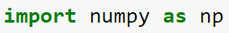
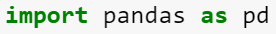
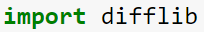
Content based - Packages

Slide 13
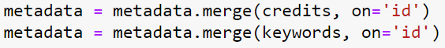
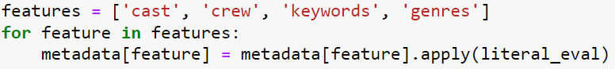
Content based – Datapreparation

Slide 14
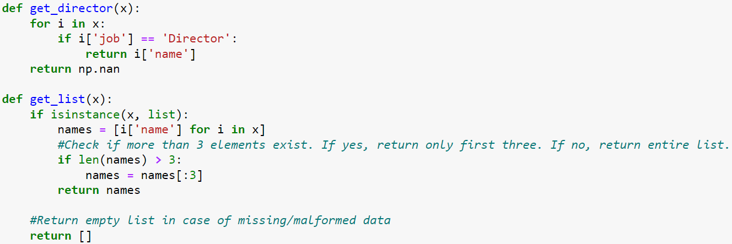
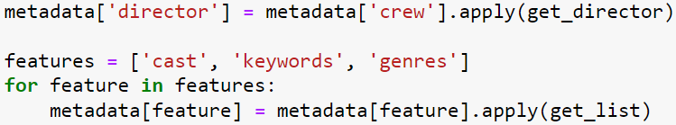
Content based – Datapreparation

Slide 15
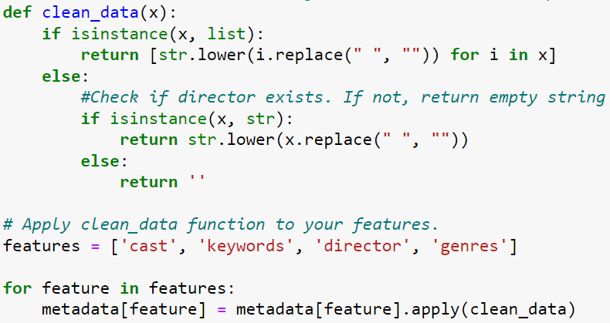
Content based – Datapreparation

Slide 16
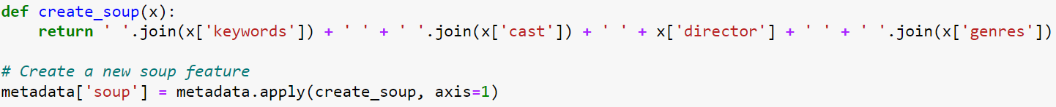
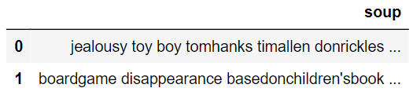
Content based – Datapreparation

Slide 17
Content-based recommendation
Film description
Attributes are joined as a lowercase string
Vector
Film A
Director
Top 3 actors
Sci-kit CountVectorizer()

Slide 18
Content-based recommendation
Vector
Film C
Vector
Film K
Vector
Film D
Vector
Film A
Vector
Film J
Vector
Film B
Vector
Film I
Vector
Film H
Vector
Film F
Vector
Film E
Vector
Film G

Slide 19
Content based – Calculation

Slide 20
Content-based recommendation
Vector
Film C
Vector
Film K
Vector
Film D
Vector
Film A
Vector
Film J
Sci-kit similarity-score
Vector
Film I
Vector
Film B
Vector
Film H
Vector
Film F
Matrix
Vector
Film E
Vector
Film G

Slide 21
Content based – From Search to Recommendation

Slide 22
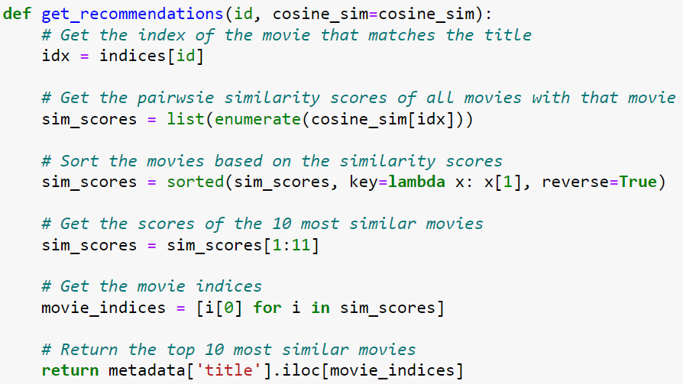
Content based – Recommendation

Slide 23
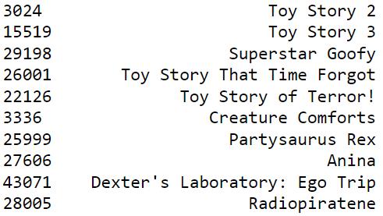
Content based – Recommendation

Slide 24
Rating based

Slide 25
Problem with original dataset
At first algorithm development using only movie ids
trying to get titles of recommended ids
After some testing: realizing that some ids are missing in metadata set
Analysis of dataset
Small:
Not in meta: 6236
In meta: 2830
Big:
Not in meta: 37550
In meta: 7565
ratings_small:
Not in: 55015
In: 44989
ratings:
Not in: 14587721
In: 11436568

Slide 26
Dataset
ratings
movies
userId
movieId
movieId
title
rating
genres
Notes:
Aufgezählt wird nur was von uns benutzt wird. Eig noch viel mehr Attribute

Slide 27
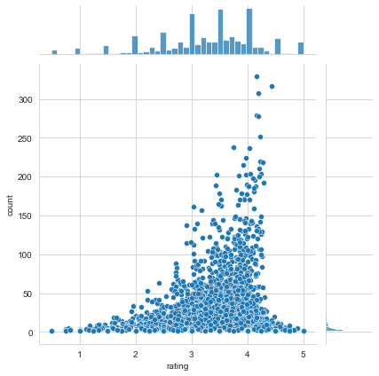
Dataset
Viewing rating data
➔ Ratings are rudimentarily normally distributed
Notes:
Aufgezählt wird nur was von uns benutzt wird. Eig noch viel mehr Attribute

Slide 28
Rating-based recommendation
correlation
 | Movie id | Movie id | Movie id
User id | N/A | 3,5 | N/A
User id | 1 | 4 | 5
User id | 3 | N/A | N/A
User id | 2 | N/A | 2
… | … | … | …
Movie id
3
5
N/A
2
…
Movie id | Correlation score
1 | 1.0
2 | 0.99
3 | 0.97
4 | 0.89
… | …

Slide 29
Content based - Packages
import pandas as pd
import collections
import copy

Slide 30
Rating-based – datapreparation
Creating table with total count of ratings for each movie id
rating_info = pd.DataFrame(ratings.groupby('movieId')['rating'].mean())
rating_info['count'] = pd.DataFrame(ratings.groupby('movieId')['rating'].count())
movieId | rating | count
1 | 3.920930 | 215
2 | 3.431818 | 110
3 | 3.259615 | 52
4 | 2.357143 | 7
5 | 3.071429 | 49

Slide 31
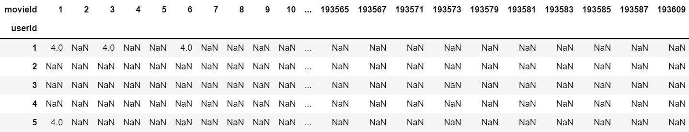
Rating-based – datapreparation
Create pivot table
rating_pivot = pd.pivot_table(ratings, index='userId', columns='movieId', values='rating')

Slide 32
Rating-based – Algorithm
def recommendation(movie_id):
#calculating correlation to other users
correlation = rating_pivot.corrwith(rating_pivot[movie_id])
#creating table
corr_movie = pd.DataFrame(correlation, columns=['correlation'])
#dropping movies non values => no correlation
corr_movie.dropna(inplace=True)
#adding total count of ratings for each movie to the table
corr_movie = corr_movie.join(rating_info['count'])
#listing movies by correlation score and just using movies with more then the 90th percentile of the total count of ratings per movie
cutoff = rating_info['count'].quantile(0.90)
corr_movie = corr_movie[corr_movie['count']>cutoff].sort_values('correlation', ascending=False)
#deleting movie that the recommendation is based on from recommendation list
if movie_id in corr_movie.index:
corr_movie = corr_movie.drop([movie_id])
#changing index to ranking and movieId to column
corr_movie['movieId'] = corr_movie.index
corr_movie = corr_movie.set_index(pd.Index(list(range(len(corr_movie)))))
return corr_movie
 | correlation | count | movieId
0 | 1.0 | 52 | 6870
1 | 1.0 | 31 | 2953
2 | 1.0 | 87 | 2011
3 | 1.0 | 48 | 2019
4 | 1.0 | 58 | 34162
... | ... | ... | ...
400 | -1.0 | 83 | 1101
401 | -1.0 | 40 | 2541
402 | -1.0 | 90 | 1610
403 | -1.0 | 39 | 2746
404 | -1.0 | 59 | 3535

Slide 33
Rating-based – Algorithm
#adding correlation score for top 5 recommended movies to dictionary
for k in range(5):
id = rec.iloc[k].array[2]
#checking if id has already been recommended
if id in rec_movies_list:
#if already recommended the correlation score of both cases are added up
rec_movies_copy = copy.deepcopy(rec_movies_dict)
rec_movies_copy.update({id: rec_movies_dict.get(id) + rec.iloc[k][0]})
rec_movies_dict = rec_movies_copy
else:
rec_movies_dict[rec.iloc[k][2]] = rec.iloc[k][0]
rec_movies_list.append(id)
def multi_recommendation(movie_ids):
#function to get recommendation as an array of titles for multiple inputs
rec_movies_list = []
rec_movies_dict = {}
for i in movie_ids:
rec = recommendation(int(i))
#skip if no correlating movies
if rec.empty:
continue
return sorted(rec_movies_dict, key=rec_movies_dict.get, reverse=True)[:10]
old score + new correlation score = new score

Slide 34
Live presentation

